Slide 1
Modeling Memory: Exploring the Relationship Between Word Overlap and Single Word Norms When Predicting Judgments and Recall
Nicholas P. Maxwell
Notes:
Today I will be briefly sharing a research project that I have been conducting on the effects of word pair relationships and judgements of these relationships on recall task performance.

Slide 2
Introduction
This study examined the effects of three measures of word overlap on judgment making and recall ability.

Slide 3
Judging Word Pair Relatedness
Ways to judge item relatedness:
How often are two words used together? (associative)
How similar in meaning are two words? (semantic)
How closely are two words connected by an overall theme? (thematic)
Notes:
The present study has participants making judgements of how related pairs of words are based on the following three measures of relatedness:
Associative
Semantic
Thematic

Slide 4
Measuring Word Pair Relatedness
Associative
Forward Strength (FSG), which is the probability of responding to a cue word with a particular target
Semantic
Calculates a cosine (COS) value representing the amount of feature overlap between two concepts.
Thematic
Latent Semantic Analysis (LSA)
Notes:
So how did we measures these relationships?
We used Forward Strength as an indicator of associative relatedness. This is the probability that a cue word will elicit a particular target word. For example, if the pair MOUSE-CHEESE has an fsg of .72, then the cue word MOUSE will elicit the response “CHEESE” approximately 72% of the time.
Semantic relatedness is being measured with Cosine. A cosine value represents the amount of feature overlap between two concepts. The higher the COS between two words, the more similar their dictionary definitions are to one another. Expanding upon our earlier example, Mouse and Cheese have a cosine of only .01, suggesting zero feature overlap.
Thematic relatedness is being measured with Latent Semantic Analysis or LSA. LSA calculates a value based on the co-occurrences of words together in a document with the overall meaning of a document. This value can be viewed as a middle ground between association and semantics.

Slide 5
Judgments of Associative Memory
Manipulated JOL task that investigates perception of word associations
Maki (2007a, 2007b)
Participants are asked to estimate the number of people out of 100 who would respond to the cue with the given target
These ratings mimic the free association process used to create word association norms

Slide 6
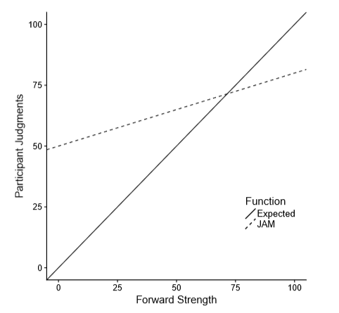
JAM Function
The JAM Function
Characterized by a high intercept and shallow slope
One goal of the pilot study was to replicate this function for associative judgments and then extend it to include semantic and thematic judgments.

Slide 7
Overview of Study
Two experiments:
Experiment One examined the effects of associative, semantic, and thematic word overlap on relatedness judgments and recall
Experiment Two attempted to replicate interaction findings from the first experiment using a new stimuli set, and to control for single word norms.

Slide 8
Goals of Experiment One
Expand previous JAM findings to include semantic and thematic judgments (Hypothesis One)
Examine interactions between IVs for judgments. (Hypothesis Three)
Examine interactions between IVs for recall. (Hypothesis Two)
Test whether judgment slopes obtained in hypothesis one are predictive of recall. (Hypothesis Four)

Slide 9
Goals of Experiment Two
Replicate interaction findings from the Experiment One with a new stimuli set
Expand upon these findings by including single word norms in the analysis

Slide 10
Method

Slide 11
Participants and Stimuli – Experiment One
112 Participants were recruited from Amazon’s Mechanical Turk
Participants completed the study online via Qualtrics
63 Word pairs of varying associative, semantic, and thematic strengths were created from the Buchanan et al. (2013) word norms
Notes:
For this study, we recruited 100 participants from Amazon’s mechanical turk. The study was conducted online via Qualtrics.
63 word pairs were of varying associative, semantic, and thematic strengths were created from 3 normed databases.

Slide 12
Participants and Stimuli – Experiment Two
221 Participants were recruited from Amazon’s Mechanical Turk
63 new word pairs created from the same database
In addition to measures of associative, semantic, and thematic overlap, these pairs were also measured on various single word norms.

Slide 13
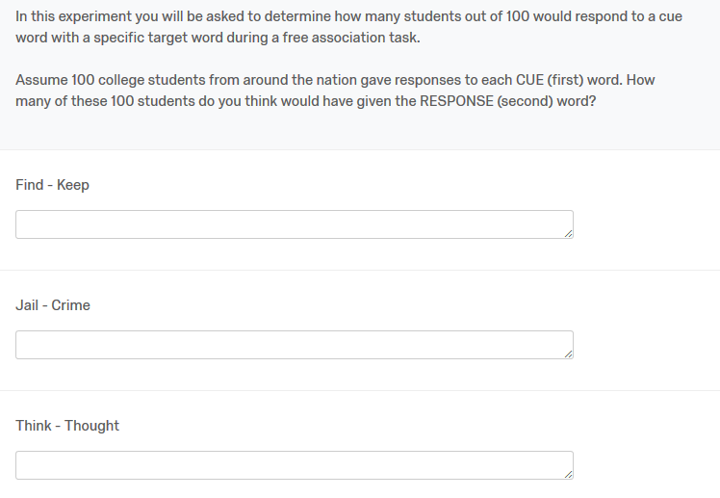
Judgment Blocks
21 word pairs per block
The instructions at the start of each block explain one of the three types of relationships (Associative, Semantic, or Thematic), and the instructions change with each block.
Judgments were made on a scale of 0 to 100, with 0 indicating no relationship and 100 indicating a perfect relationship
Notes:
Three Judgment blocks, 21 words per block (7 low strength, 7 medium strength, 7 high strength). At the beginning of each block, participants receive instructions explaining associative, semantic, or thematic relationships and are asked to judge each word pair’s relatedness based on that criteria. These judgements are made on a scale of 0 to 100.
The picture is an example of the instructions participants receive for the associative judgment block.
There are three different versions of the study that rotate which instructions appear with which block and counter balance the order of the blocks. The end result is that each word pair receives judgements based on all three criteria.

Slide 14
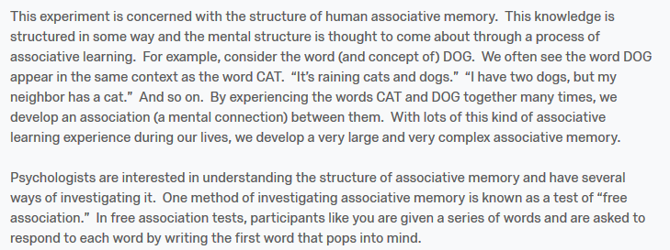
Judgment Blocks – Instructions
Example from Associative Condition

Slide 15
Recall Phase
Participants are presented with the first word from each of the pairs they previously judged and are asked to recall the target word it was paired with.
All 63 pairs are presented in a randomized order.
Notes:
The final section of the study is a cued recall phase. In this section participants are presented with each of the 63 cue words from the judgement blocks and are asked to respond with the correct target word. The cue words appear in a randomized order and participants are allowed to take as long as needed to complete this section.

Slide 16
Study Design – Experiment One
IVs
DVs
Judgment type (control)
Associative Strength (FSG)
Semantic Strength (COS)
Thematic Strength (LSA)
Interactions
Recall Score
Judgment Value
Notes:
The data was analyzed with a Multi-Level Model and Logistic Regression.
List IV’s and DV’s

Slide 17
Study Design – Experiment Two
IVs
DVs
Judgment type (control)
Associative Strength (FSG)
Semantic Strength (COS)
Thematic Strength (LSA)
Interactions
Single Word Norms
Recall Score
Judgment Value
Notes:
The data was analyzed with a Multi-Level Model and Logistic Regression.
List IV’s and DV’s

Slide 18
Single Word Norms
Lexical Properties
Length
Frequency
Phonemes
Morphemes
Syllables

Slide 19
Single Word Norms
Rated Properties
Age of Acquisition
Imageability
Concreteness
Valence
Familiarity

Slide 20
Single Word Norms
Neighborhood Connections
Cue and Target Set Sizes
Feature Set Size
Cosine Connectedness
Orthographic neighborhood
Phonographic neighborhood

Slide 21
Data Processing
And descriptive statistics

Slide 22
Analysis – Experiment One
Multi-level modeling was used to analyze the data
Each participant’s individual judgment and recall ratings are treated as separate data points.
Missing data points were coded as NA, and one judgment score was removed for being out of range.
Participants who did not follow instructions were also removed (i.e., responding with words for item judgments)
In total, 787 data points were excluded, leading to 6,269 observations taken from 105 participants.

Slide 23
Replication Analysis – Experiment Two
Nine out of range data points were coded as NA (e.x., data points > 100)
Five outliers were removed
1,472 data points were excluded (833 judgment only, 393 recall only, and 246 across both categories)
The final dataset used for the Experiment Two replication analyses contained 12,451 observations from 211 participants.

Slide 24
Single Word Norm Analysis – Experiment Two
When examining single word norms, the original Experiment Two dataset was combined the dataset used in Experiment One, which was updated to contain single word norm information.
This combined dataset contained a total of 18,713 data points collected from 333 participants.

Slide 25
Correlations between Single Word Norms
Correlations between various measures of word length (number of characters, syllables, morphemes, and phonemes) were r > .75.
Because of this, only number of characters was used to measure word length.

Slide 26
Combined Analysis – Experiment Two
Stepwise regression was used to select the strongest single word predictors for steps one, two, and three of the final model.
IVs for Final Judgment Model:
IVs for Final Recall Model:
Step 1: Length 1, Length 2, Frequency 1, Frequency 2
Step 2: AOA 1, AOA2, Familiarity 1, Familiarity 2, Valence 1, Valence 2, Imageability 1, Imageability 2, Concreteness 1, Concreteness 2
Step 3: QSS, TSS, FSS 1, FSS 2, COSC 2, Ortho 2, Phono 1
Step 4: FSG, COS, LSA
Step 1: Length 1, Length 2, Frequency 1, Frequency 2
Step 2: AOA 1, AOA 2, Familiarity 1, Familiarity 2, Valence 1, Valence 2, Imageability 1, Concreteness 2
Step 3: QSS, TSS, FSS 1, FSS 2, Ortho 1, Ortho 2, Phono 1, Phono 2
Step 4: FSG, COS, LSA
Note: 1 = Cue Item, 2 = Target Item

Slide 27
Descriptive Statistics for Network Norms
Experiment One
Experiment Two
Variable | M (SD) | Min | Max
FSG | 0.15 (0.19) | 0.01 | 0.75
COS | 0.44 (0.28) | 0.00 | 0.88
LSA | 0.36 (0.19) | 0.03 | 0.90
Variable | M (SD) | Min | Max
FSG | 0.13 (0.19) | 0.01 | 0.83
COS | 0.42 (0.29) | 0.00 | 0.84
LSA | 0.38 (0.20) | 0.05 | 0.88

Slide 28
Descriptive Statistics for Single Word Norms
Cue Items
Predictor | Citation | Mean (SD) | Minimum | Maximum
QSS | Nelson et al., 2004 | 14.75 (4.49) | 4.00 | 27.00
Concreteness | Nelson et al., 2004 | 5.27 (1.09) | 1.98 | 7.00
SUBTLEX | Brysbaert & New, 2009 | 3.14 (0.77) | 1.34 | 5.35
Length | Buchanan et al., 2013 | 5.07 (1.43) | 3.00 | 10.00
Ortho N | Buchanan et al., 2013 | 6.44 (5.79) | 0.00 | 20.00
Phono N | Buchanan et al., 2013 | 16.55 (14.38) | 0.00 | 51.00
Phonemes | Buchanan et al., 2013 | 4.11 (1.32) | 2.00 | 9.00
Syllables | Buchanan et al., 2013 | 1.43 (0.67) | 1.00 | 4.00
Morphemes | Buchanan et al., 2013 | 1.06 (0.24) | 1.00 | 2.00
AOA | Kuperman et al., 2012 | 5.50 (1.75) | 2.47 | 11.05
Valence | Warriner et al., 2013 | 5.69 (1.17) | 1.91 | 7.89
Imageability | Toglia & Battig, 1978 | 5.41 (0.76) | 3.02 | 6.61
Familiarity | Toglia & Battig, 1978 | 6.18 (0.29) | 5.30 | 6.79
FSS | Buchanan et al., 2013 | 15.04 (10.46) | 5.00 | 57.00
COSC | Buchanan et al., 2013 | 81.94 (73.59) | 1.00 | 347.00

Slide 29
Descriptive Statistics for Single Word Norms
Target Items
Predictor | Citation | Mean (SD) | Minimum | Maximum
QSS | Nelson et al., 2004 | 14.79 (5.06) | 5.00 | 29.00
Concreteness | Nelson et al., 2004 | 5.34 (1.05) | 1.28 | 7.00
SUBTLEX | Brysbaert & New, 2009 | 3.34 (0.68) | 1.59 | 5.36
Length | Buchanan et al., 2013 | 4.81 (1.68) | 2.00 | 10.00
Ortho N | Buchanan et al., 2013 | 8.10 (7.47) | 0.00 | 29.00
Phono N | Buchanan et al., 2013 | 19.16 (15.93) | 0.00 | 59.00
Phonemes | Buchanan et al., 2013 | 3.86 (1.50) | 1.00 | 10.00
Syllables | Buchanan et al., 2013 | 1.35 (0.65) | 1.00 | 4.00
Morphemes | Buchanan et al., 2013 | 1.06 (0.23) | 1.00 | 2.00
AOA | Kuperman et al., 2012 | 4.92 (1.66) | 2.47 | 11.63
Valence | Warriner et al., 2013 | 5.81 (1.13) | 1.95 | 7.89
Imageability | Toglia & Battig, 1978 | 5.46 (0.75) | 2.95 | 6.45
Familiarity | Toglia & Battig, 1978 | 6.28 (0.29) | 5.19 | 6.85
FSS | Buchanan et al., 2013 | 16.58 (12.95) | 5.00 | 57.00
COSC | Buchanan et al., 2013 | 91.28 (89.90) | 2.00 | 462.00

Slide 30
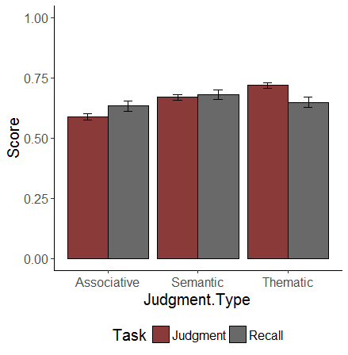
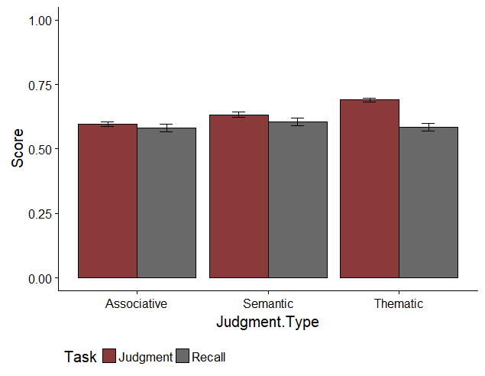
Mean Judgment and Recall Scores
Experiment One
Experiment Two
Notes:
The type of judgement being made did not effect recall. The percent of word pairs correctly recalled hovered around 60% for each of the three types of judgements. However, the type of judgement being made did have an effect on the relatedness values that participants assigned. Participants were more likely to rate the thematic relationships as being more similar. This may in part be due to the fact that thematics can be viewed as a combination of association and semantics, meaning that there is more information encoded in the word pairs for participants to work with.

Slide 31
Results
Experiment One

Slide 32
Hypothesis One
Variable | Mean (SD) | t (df) | p
A Intercept | .511 (0.245) | 20.864 (99) | < .001
A COS | -.030 (0.284) | -1.071 (99) | .287
A FSG | .491 (0.379) | 12.946 (99) | < .001
A LSA | .035 (0.317) | 1.109 (99) | .270
S Intercept | .587 (0.188) | 31.530 (101) | < .001
S COS | .059 (0.243) | 2.459 (101) | .016
S FSG | .118 (0.382) | 3.128 (101) | .002
S LSA | .085 (0.304) | 2.816 (101) | .006
T Intercept | .656 (0.186) | 35.475 (100) | < .001
T COS | -.081 (0.239) | -3.405 (100) | < .001
T FSG | .192 (0.306) | 6.290 (100) | < .001
T LSA | .188 (0.265) | 7.111 (100) | < .001
The JAM slope was successfully replicated for FSG in the associative judgment condition, with FSG significantly predicting association, although the slope was slightly higher than expected at 0.491. COS and LSA did not significantly predict association.
JAM slopes were not replicated semantic or thematic judgments.
Although JAM slopes were not perfectly replicated within each judgment type, the high intercepts and shallow slopes present in all three conditions are still indicative of overconfidence and insensitivity in participant judgments.

Slide 33
Hypotheses Two and Three
This set of hypotheses investigated the effects of associative, semantic, and thematic word overlap on judgments and recall.
Hypothesis Two investigated judgments
Hypothesis Three investigated recall
Both hypotheses used maximum likelihood multilevel models and tested for three-way interactions between the network norms. Hypothesis Three incorporated a logistic regression into the model to account for the binary nature of recall.

Slide 34
MLM Results – Judgments
Main Effects Table
IV | b | Std. Error | t | p
FSG | 0.27 | 0.03 | 9.42 | < .001
COS | -0.10 | 0.02 | -6.08 | < .001
LSA | 0.09 | 0.02 | 4.20 | < .001
Notes:
These results show that both FSG and COS strength significantly predict performance on the recall task. The judged value that participants assigned to the word pairs was also a significant predictor of recall performance.
FSG is the strongest predictor of recall, followed Judged Value and COS. LSA is not a significant predictor. These results suggest that how associatively related two words are plays a strong role in how likely an individual is to remember them.

Slide 35
MLM Results – Recall
Main Effects Table
IV | b | Std. Error | z | p
FSG | 0.65 | 0.04 | 14.68 | < .001
COS | 0.18 | 0.03 | 5.54 | < .001
LSA | -0.06 | 0.04 | -1.60 | .11
Notes:
These results show that both FSG and COS strength significantly predict performance on the recall task. The judged value that participants assigned to the word pairs was also a significant predictor of recall performance.
FSG is the strongest predictor of recall, followed Judged Value and COS. LSA is not a significant predictor. These results suggest that how associatively related two words are plays a strong role in how likely an individual is to remember them.

Slide 36
Three-Way Interactions
Task | b | Standard Error | Test Statistic | p
Recall | 24.572 | 6.048 | 4.063 | < .001
Judgment | 3.324 | .490 | 6.791 | < .001

Slide 37
Simple Slopes Analysis Analyses
Judgments
Recall

Slide 38
Three-Way Interactions – Block One Only
Task | b | Standard Error | Test Statistic | p
Recall | 22.685 | 10.354 | 2.161 | .028
Judgment | 4.040 | 0.800 | 5.052 | < .001

Slide 39
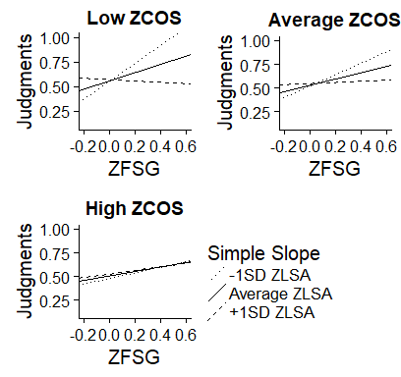
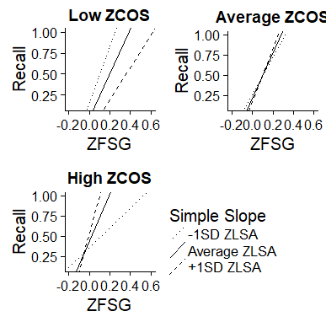
Examining Block One Only
Judgments
Recall

Slide 40
Hypothesis Four
Analysis was conducted with a multilevel logistic regression
Each database slope and intercept were used as predictors of recall using participant as a random intercept factor. These analyses were separated by judgment type.
In the associative condition, FSG slope signiﬁcantly predicted recall (b = 0.898, p = 0.008
In the semantic condition, COS slope (b = 2.039, p < 0.001) and LSA slope (b = 1.061, p = 0.020) were both found to be signiﬁcant predictors.
Finally, no predictors were signiﬁcant in the thematic condition, though LSA slope was found to be the strongest (b = 0.896, p = 0.090)
Variable | b (SE) | z | p
(Intercept) | -.432 (.439) | -.983 | .326
A Intercept | 1.514 (.604) | 2.507 | .012
A COS | .314 (.550) | .572 | .568
A FSG | .898 (.337) | 2.667 | .008
A LSA | .501 (.463) | 1.081 | .279
(Intercept) | -.827 (.463) | -1.787 | .074
S Intercept | 2.292 (.681) | 3.363 | < .001
S COS | 2.039 (.518) | 3.939 | < .001
S FSG | .381 (.289) | 1.319 | .187
S LSA | 1.061 (.455) | 2.335 | .020
(Intercept) | .060 (.599) | .101 | .920
T Intercept | 1.028 (.756) | 1.360 | .174
T COS | .792 (.566) | 1.401 | .161
T FSG | -.394 (.441) | -.894 | .371
T LSA | .896 (.529) | 1.694 | .090

Slide 41
Results
Experiment Two

Slide 42
Judgment Replication
Main Effects Table
IV | b | Std. Error | z | p
FSG | .422 | .020 | 20.622 | < .001
COS | .011 | .011 | 1.054 | .293
LSA | .132 | .018 | 7.386 | < .001
Notes:
These results show that both FSG and COS strength significantly predict performance on the recall task. The judged value that participants assigned to the word pairs was also a significant predictor of recall performance.
FSG is the strongest predictor of recall, followed Judged Value and COS. LSA is not a significant predictor. These results suggest that how associatively related two words are plays a strong role in how likely an individual is to remember them.

Slide 43
Recall Replication
Main Effects Table
IV | b | Std. Error | t | p
FSG | .633 | .099 | 6.421 | < .001
COS | .681 | .163 | 4.180 | < .001
LSA | .780 | .198 | 9.081 | < .001
Notes:
These results show that both FSG and COS strength significantly predict performance on the recall task. The judged value that participants assigned to the word pairs was also a significant predictor of recall performance.
FSG is the strongest predictor of recall, followed Judged Value and COS. LSA is not a significant predictor. These results suggest that how associatively related two words are plays a strong role in how likely an individual is to remember them.

Slide 44
Three-Way Interactions for Replication
Task | b | Standard Error | Test Statistic | p
Recall | -22.464 | 3.671 | -6.119 | < .001
Judgment | .193 | .410 | .471 | .638

Slide 45
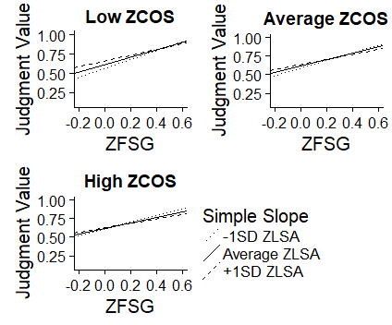
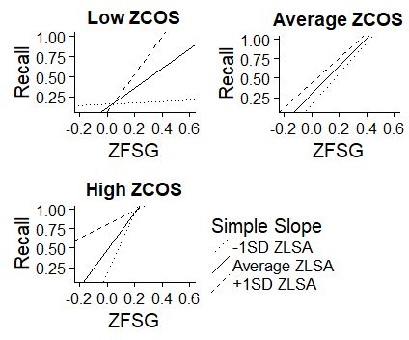
Simple Slopes for Replication
Judgment
Recall

Slide 46
Single Word Norms – Judgments
Step | IV | b (SE) | t | p
One | SUBTLEX 1 | .014 (.003) | 4.308 | < .001
 | SUBTLEX 2 | -.032 (.003) | -9.219 | < .001
 | Length 1 | -.005 (.001) | -2.790 | .005
 | Length 2 | -.001 (.001) | -.819 | .413
Two | AOA 1 | .015 (.002) | 7.416 | < .001
 | AOA 2 | -.014 (.002) | -6.348 | < .001
 | Familiarity 1 | .075 (.013) | 5.694 | < .001
 | Familiarity 2 | -.091 (.011) | -8.160 | < .001
 | Valence 1 | -.001 (.002) | -.072 | .425
 | Valence 2 | -.022 (.002) | -10.257 | < .001
 | Imageability 1 | .053 (.005) | 10.256 | < .001
 | Imageability 2 | -.074 (.005) | -13.440 | < .001
 | Concreteness 1 | -.015 (.004) | -4.144 | < .001
 | Concreteness 2 | .045 (.004) | 10.128 | < .001
Three | QSS | .005 (.001) | -8.910 | < .001
 | TSS | -.002 (.001) | -3.676 | .160
 | FSS 1 | -.001 (.001) | -4.339 | < .001
 | FSS 2 | .001 (.001) | 4.884 | < .001
 | Ortho N 2 | .001 (.001) | 7.403 | < .001
 | Phono N 1 | -.001 (.001) | -7.789 | < .001
 | COSC 2 | -.001 (.001) | -3.288 | .010
Four | FSG | .391 (.021) | 18.186 | < .001
 | LSA | .123 (.106) | 7.919 | < .001
 | COS | .027 (.011) | 2.429 | .015
Data was entered into the analysis hierarchically.
Step 1: Lexical Properties
Step 2: Participant Ratings
Step 3: Neighborhood Connections
Step 4: Word Overlap
Note: 1 = Cue item, 2 = Target Item. FSG, COS, and LSA have been mean centered. Statistics are reported for the step in which the variable was entered into the model.

Slide 47
Single Word Norms – Recall
Step | IV | b (SE) | t | p
One | SUBTLEX 1 | -.257 (.280) | -9.234 | < .001
 | SUBTLEX 2 | .082 (.030) | 2.761 | .006
 | Length 1 | .138 (.015) | 9.225 | < .001
 | Length 2 | -.047 (.012) | -3.866 | < .001
Two | AOA 1 | -.023 (.018) | -1.331 | .183
 | AO1 2 | -.087 (.019) | -4.474 | < .001
 | Familiarity 1 | -.587 (.118) | -4.975 | < .001
 | Familiarity 2 | -.283 (.098) | -2.873 | .004
 | Valence 1 | -.143 (.020) | -7.269 | < .001
 | Valence 2 | -.012 (.019) | -.619 | .536
 | Imageability 1 | .086 (.032) | 2.697 | .007
 | Concreteness 2 | .131 (.027) | -4.838 | < .001
Three | QSS | .001 (.003) | .271 | .786
 | TSS | -.015 (.004) | -3.401 | < .001
 | FSS 1 | -.012 (.002) | -5.494 | < .001
 | FSS 2 | .015 (.002) | 7.305 | < .001
 | Ortho N 1 | -.017 (.006) | -3.023 | .003
 | Ortho N 2 | -.007 (.004) | -1.579 | .114
 | Phono N 1 | -.001 (.002) | -.117 | .907
 | Phono N 2 | -.007 (.002) | -3.087 | .002
Four | FSG | 1.866 (.210) | 8.880 | < .001
 | LSA | .867 (.146) | 4.710 | < .001
 | COS | 0.278 (.102) | 2.713 | .007
This analyses used the same hierarchical structure that was used for analyzing judgments.
Note: 1 = Cue item, 2 = Target Item. FSG, COS, and LSA have been mean centered. Statistics are reported for the step in which the variable was entered into the model.

Slide 48
Three-Way Interactions for Single Word Norms
Task | b | Standard Error | Test Statistic | p
Recall | -8.808 | 3.161 | -2.786 | .005
Judgment | .558 | .338 | 1.648 | .099

Slide 49
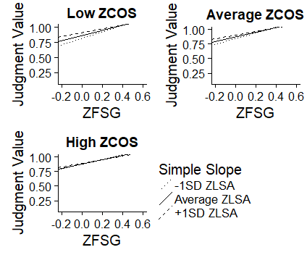
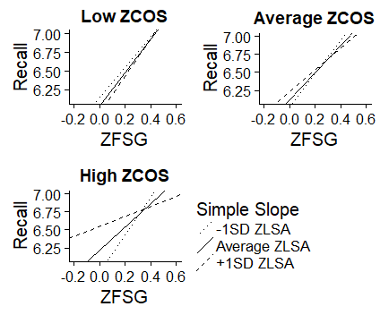
Simple Slopes for Single Word Norms
Judgment
Recall

Slide 50
Summary and Discussion

Slide 51
Summary – Experiment One
Experiment One investigated the relationship between associative, semantic, and thematic word relations and their eﬀect on participant judgments and recall performance through the testing of four hypotheses.
In Hypothesis One, bias and sensitivity ﬁndings ﬁrst proposed by Maki (2007a) were successfully replicated in the associative condition, with slope and intercept values falling within the expected range. These findings were not fully replicated in the other two conditions, but participants still displayed high intercepts and shallow slopes, though they were outside of the appropriate range.

Slide 52
Summary – Experiment One
Hypothesis Two examined the three-way interaction between FSG, COS, and LSA when predicting participant judgments.
At low semantic overlap, a seesaw eﬀect was found in which increases in thematic strength led to decreases in associative predictiveness.
This ﬁnding was then replicated in Hypothesis Three when extending the analysis to predict recall.

Slide 53
Summary – Experiment One
Hypothesis Four used the judgment slopes and intercepts calculated in Hypothesis One to investigate if participants’ bias and sensitivity to word relatedness could be used to predict recall.
In the associative condition, the FSG slope signiﬁcantly predicted recall.
In the semantic condition, recall was signiﬁcantly predicted by both the COS and LSA slopes.
In the thematic condition, although the LSA slope was the strongest, no predictors were signiﬁcant.

Slide 54
Summary – Experiment Two
Experiment Two sought to replicate interaction findings from the first experiment, first when using a novel set of stimuli and then when controlling for single word norms.
For the initial replication, the three-way interaction was not significant when predicting participant judgments. Although the three-way interaction was not significant, a simple slopes analysis showed that FSG and LSA strengths were competitive with another at each level of semantic overlap.
When extending this initial replication to predict recall, a significant three-way interaction was detected between the network norms, although this interaction was in the opposite direction as the original findings from the first experiment (FSG and LSA strength were complimentary at low levels of semantics and became increasingly competitive at high levels).

Slide 55
Summary – Experiment Two
Similar results were found when controlling for single word norms.
No significant three-way interaction was detected when predicting judgment scores. Simple slopes analyses showed that increasing thematic overlap between pairs decreased the predictiveness of FSG at all levels of semantic overlap (i.e., competition at all levels).
When recall was examined as the dependent variable of interest, the three-way interaction between network norms was significant. Again, the direction of this interaction was opposite to that found in Experiment One, which was consistent with the previous interaction

Slide 56
General Discussion
While previous research has shown that memory networks are divided into separate systems which handle storage and processing for meaning and association, the presence of these interactions suggests that connections exist between these networks, linking them to one another.
One interpretation is that these memory systems form a three-tiered, interconnected system.
First, information enters the semantic memory network, which processes features of concepts and provides a means of categorizing items based on the similarity of their features.
Next, the associative network adds information for items based on contexts generated by reading or speech.
Finally, the thematic network pulls in information from both the semantic and associative networks to create a mental representation of both the item and its place world relative to other concepts.

Slide 57
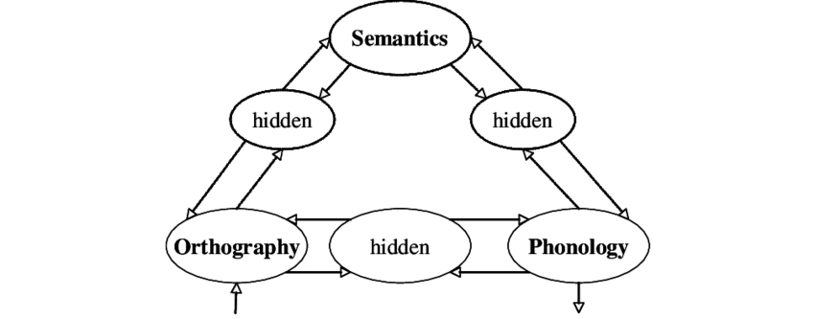
General Discussion
The present study can be viewed within the context of Seidenberg and McClelland’s 1989 “triangle model” of reading.
The original model dealt with reading, and focused on the link between orthography and phonology.
Harm & Seidenberg (2004) developed a version of the model with a focus on semantics, with word meaning being derived from orthographic and phonographic input.
Triangle Model: Seidenberg & McClelland, 1989

Slide 58
General Discussion
In several instances, cue and target slopes appeared to balance out another in both judgment and recall models. (i.e., cue slope was positive, but target slope was negative.
The bi-directional pathways in the triangle model may explain this trend of cue and target slopes balancing one another.
As both cue and target are activated in memory, the networks for these concepts are also activated.
Each appears to be correspondingly weighted, potentially indicating that the focus of attention was spread across cue and target and these were weighted evenly .

Slide 59
Limitations
Pairs were randomly selected based on cosine values. This method was used to get a range of LSA and FSG scores, but the set of norms used to generate the stimuli contained a disproportionate number of pairs that were low in FSG or LSA compared to pairs high in overlap.
For example, there were a total of 356 high COS pairs in the dataset. Of these pairs, 326 were low in FSG. Only two pairs in the entire dataset had high overlap on all three measures.

Slide 60
Limitations
The stimuli used in Experiment Two also had to be included across several unconnected databases of single word norms. This greatly limited which words could be selected.
To help control for this, single word norms were gathered for the stimuli set used in Experiment One. Data was then combined across experiments. It should be noted that this dataset contained several NA values across each single word norm, as some of the cue and target items were missing from various databases.

Slide 61
Limitations
Although mean judgment and recall scores were fairly stable across both experiments, some of the discrepancy between interaction findings (in particular the change in the direction of the interaction when predicting recall) may be remedied by using a more balanced set of stimuli.
Future studies should focus on creating overlap between current normed databases, and on creating larger, more comprehensive collections of word norms to use in these types of studies.

